Slide 1



🔍 Lost something?
📢 Found something?
📌 Notice boards are ignored?
📱 WhatsApp groups are chaos?
🕵️ Tracking items feels like solving a crime?

Slide 2

Foundly
Lost it - List it - Find it

Slide 3
Roopa Anche
Team Members
Sowjanya
Subham Subedi
Rakesh
Akanksha

Slide 4
Lost & Found Item Reporting
Objectives
My Activity Dashboard
Claim & Handover Requests
Notifications

Slide 5
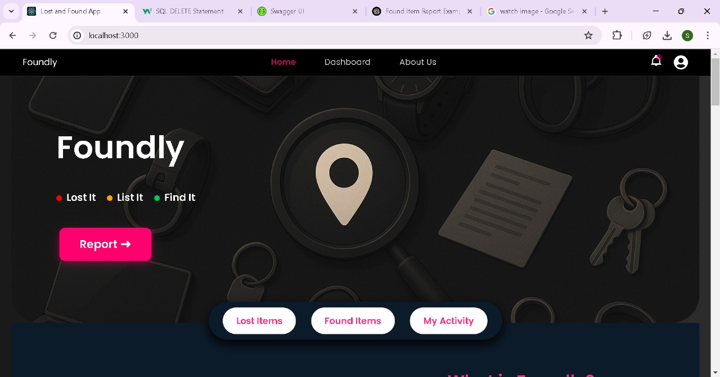

Slide 6
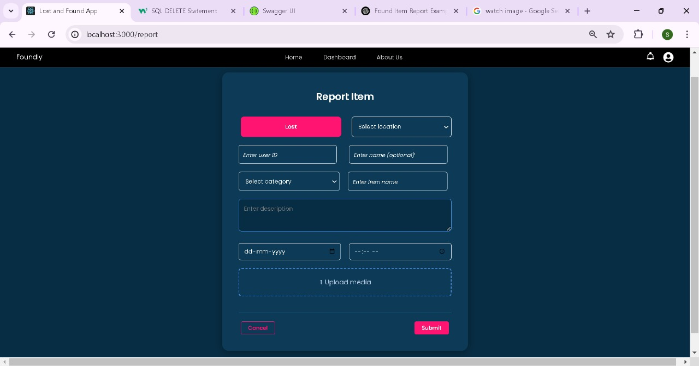
Item Report
Select category and location
Upload photo
If found item Report choose handover options
Post appears on Lost Items and My Activity

Slide 7
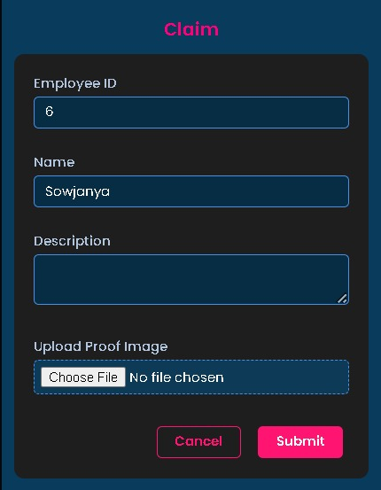
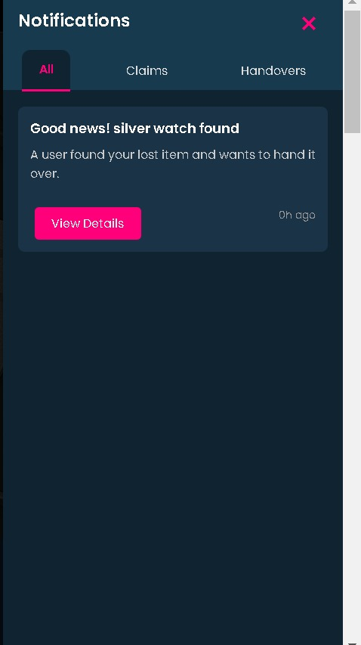
Handover and Claim Process
Notifications
S
User finds a matching lost/found report
Initiates a claim or handover request
Chooses return method: direct pickup or security desk
Notification
The user who repoted gets the notification as soon as the request is submitted in the notifications page
Claim Form

Slide 8
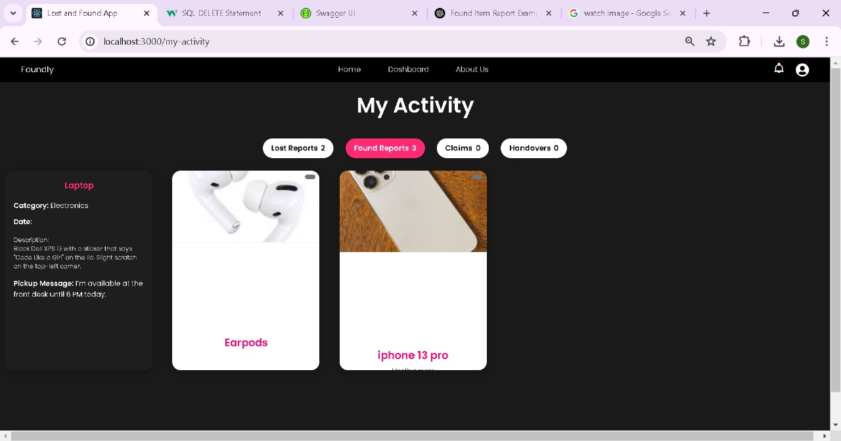
Organized into 4 Key Sections:
📝 My Lost Reports
🔍 My Found Reports
📥 My Claims
📤 My Handovers
My Activity

Slide 9
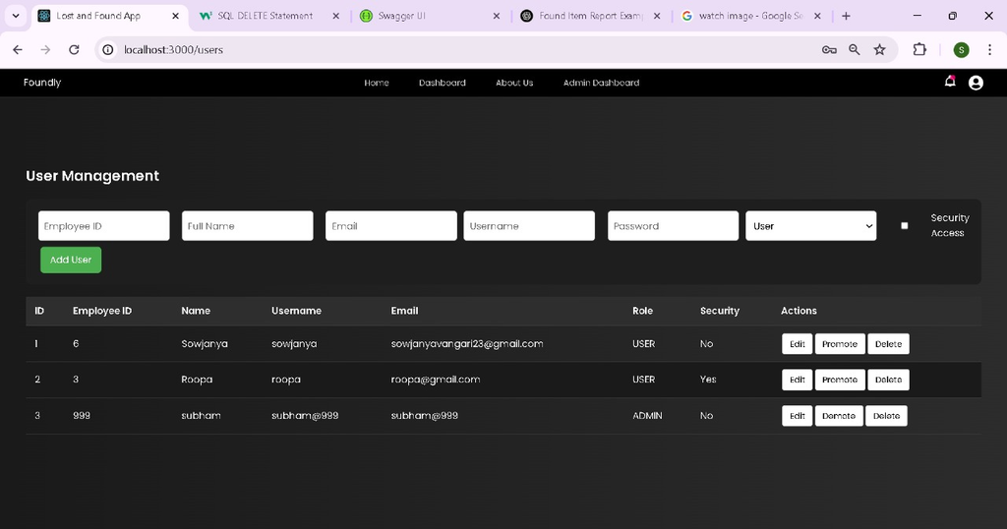
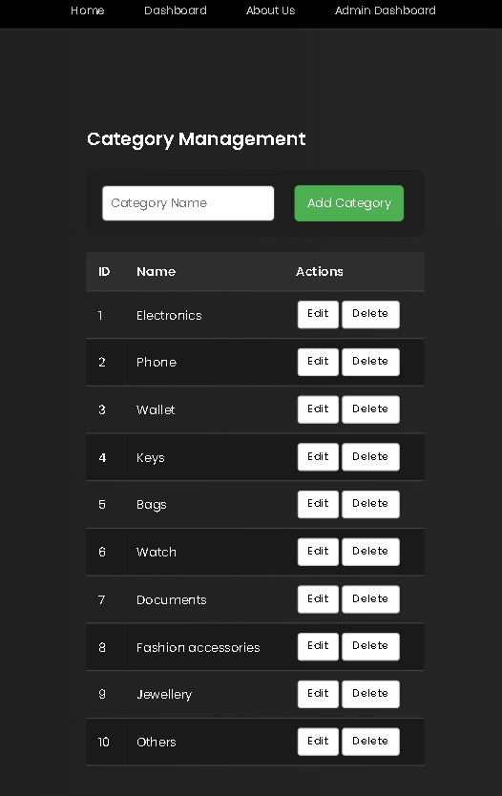
Admin Page
Add, Update and Delete User
Add, Update, Delete Categories
Update the roles
Approve someone as security

Slide 10









Tech Stack
Frontend - React
Backend - Springboot
DataBase - Mysql
Testing
Deployment - Docker

Slide 11
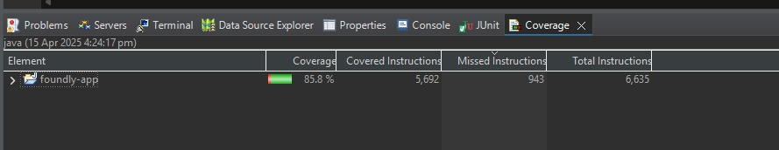
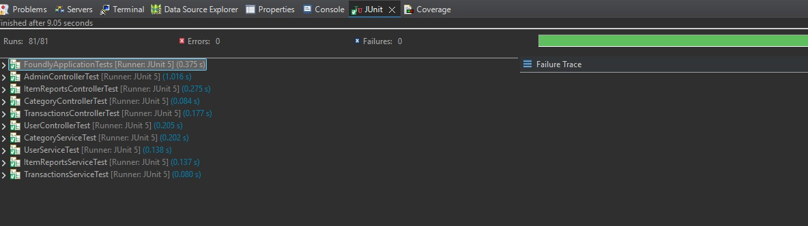
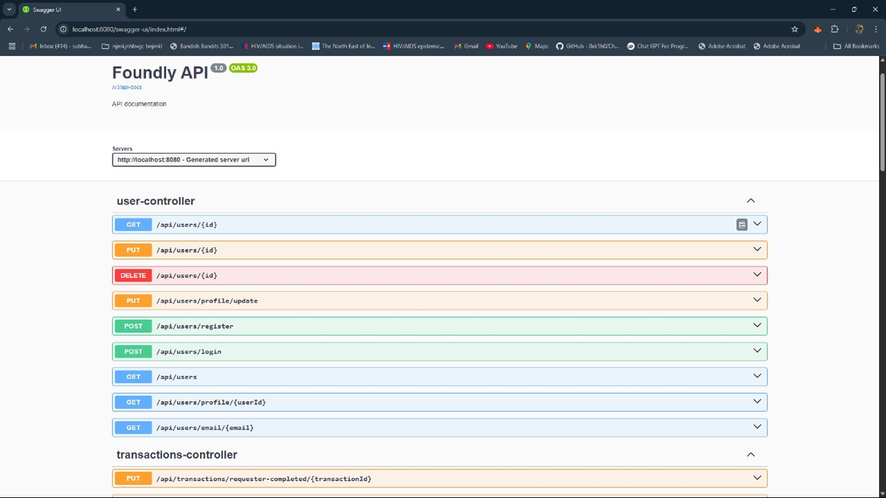
Junit Testing
Swagger

Slide 12
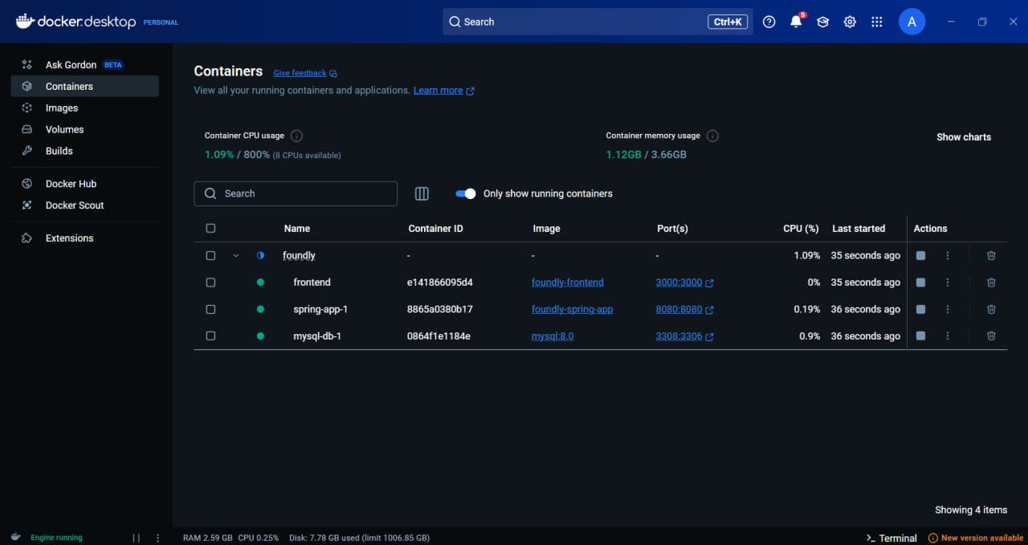
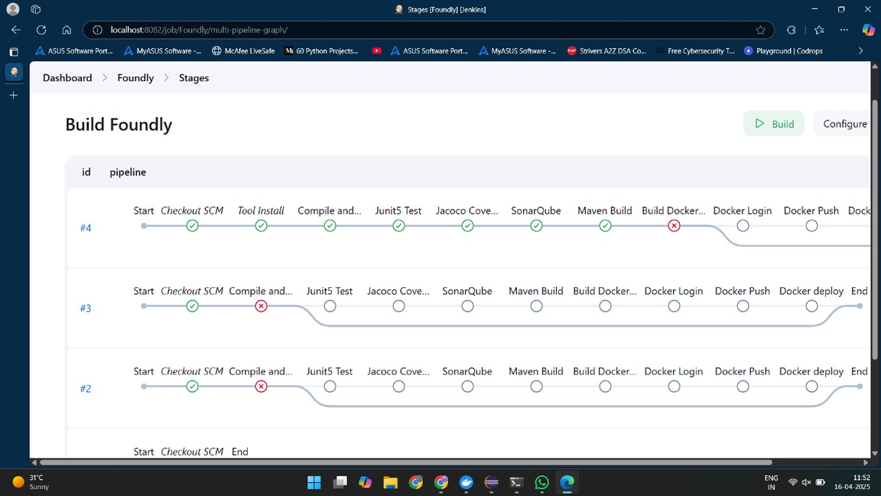
Docker
Jenkins

Slide 13
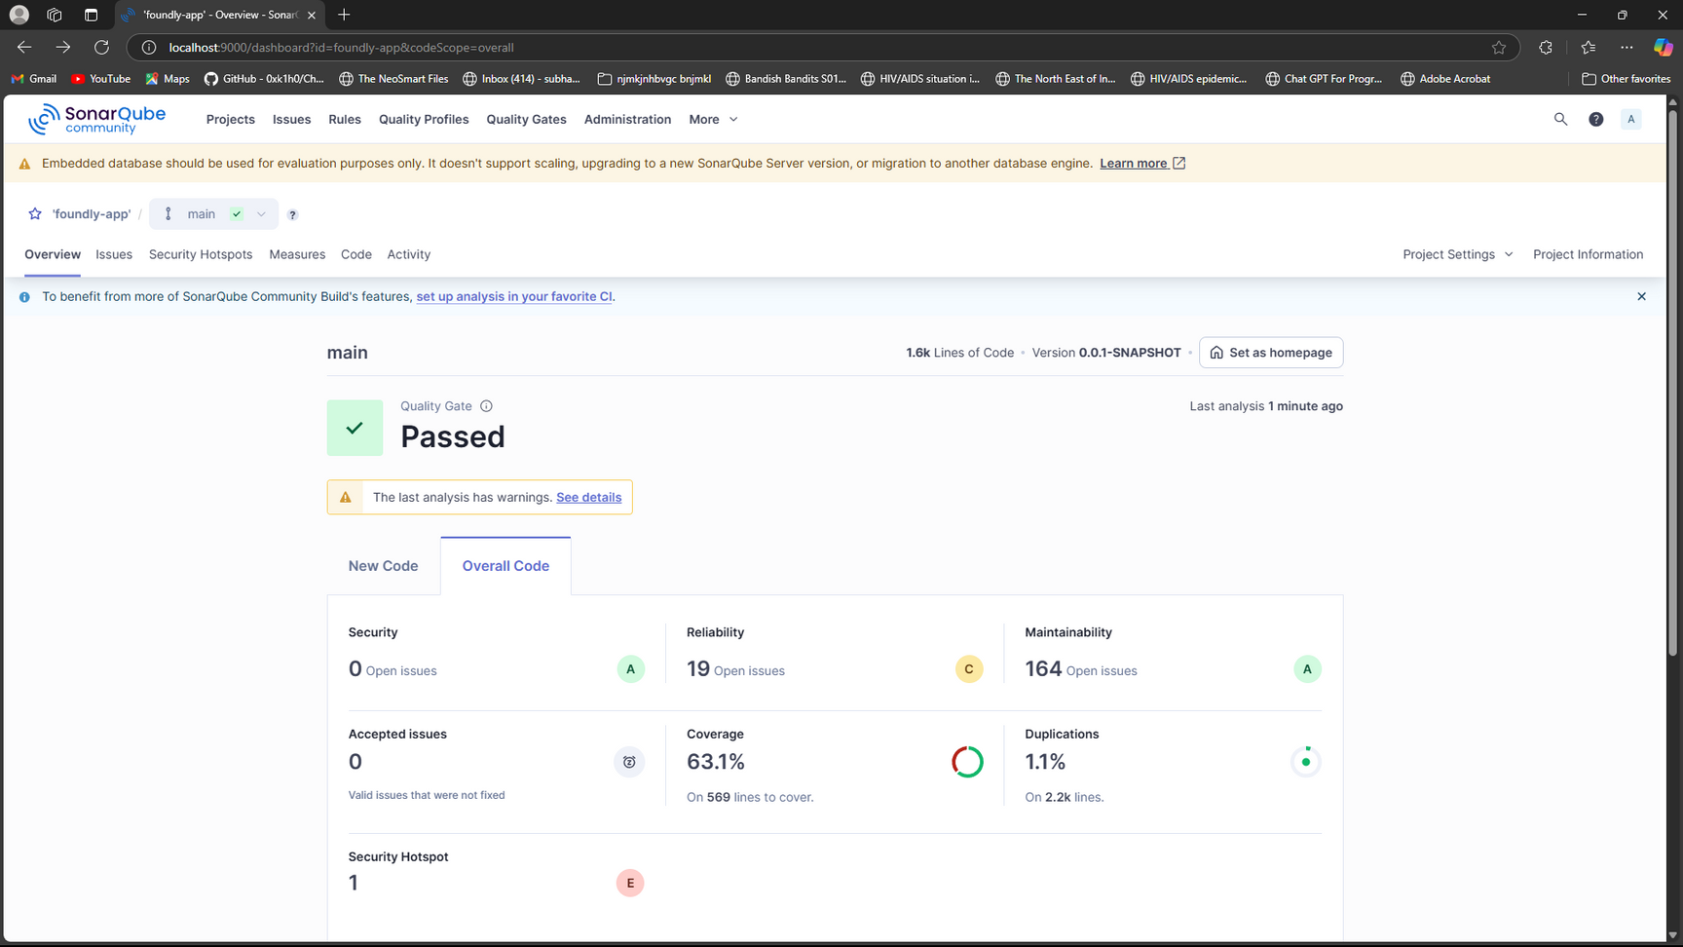
SonarQube

Slide 14

Future Scope
Dynamic Analytics Dashboard
AI Based Item Matching
Mobile Application
Improve Authentication
ChatBot

Slide 15

Thank You

